Slide 1
Logical Database Design & Relational Model
Lecture - 06

Slide 2
Learning Outcome
LO3: Model data requirements using data models

Slide 3
In this lecture you will learn
What is logical database design?
How to derive a logical model from the information represented in the ER model (conceptual model)
We focus on one type of logical model which is relational model

Slide 4
Relational Model
Data model on which most DBMS implementations are based. CODD 1970
Simple & elegant mod:
Everything is a relation (= table)
Every relation is a table with rows & columns
There are standard ways to convert from
the E-R model (conceptual model )
Relational model (logical model )

Slide 5
Relational Model (contd.)
The relational model represents the database as a collection of relations.
Relation consists of
Relation schema
Relation instance (table)

Slide 6
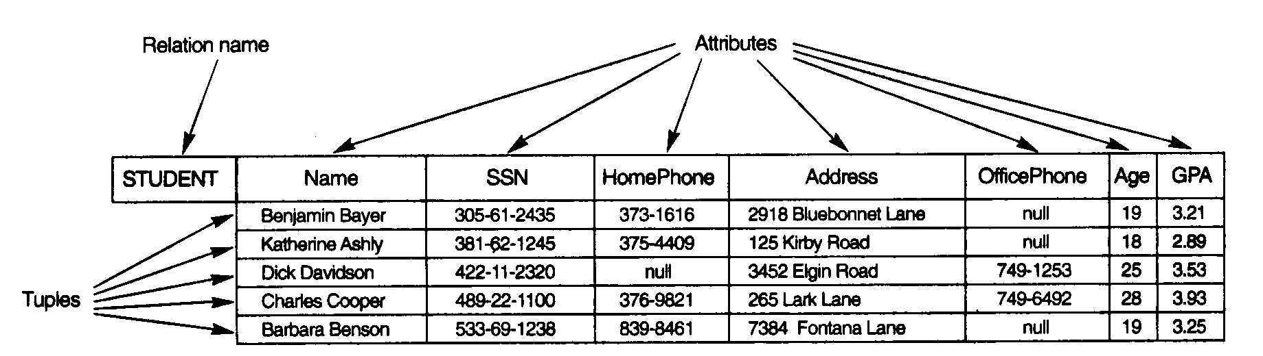
Relation
RELATION:
Schema
Instance

Slide 7
Relation Schema
Describes the column heads (attributes) of the relation
name of the relation,
name of each filed,
domain of each field
Domain : is described by domain name and set of associated values

Slide 8
Relation Schema
Students
(sid:string,
name:string,
login:string,
age :integer,
gpa :real )
Schema Name(relation name)
Field name
domain
Domain GPA : real (0-4)

Slide 9
Relation Instance
Set of tuples or records or rows :
Each tuple has the same number of fields as the relation schema
Example : Relation Instance

Slide 10
Degree of a relation
The degree of R is the number of attributes in R
(ID,Name,Address,Phone)=4
ID | Name | Address | Phone
100 | Sampath | Moratuwa | 01992883
110 | Amali | Colombo -3 | 01983733
120 | Sanath | Negombo | null

Slide 11
Example
Make a list of students in the class, keeping their ID, name and phone number.
This is the basic structure of the relation model, a table or relation.
ID | Name | Phone
S01 | Mike | 111
S02 | Elisa | 222

Slide 12
Formalizing : Relations
Definition: A relation is a named table of data
– Table is made up of rows (records or tuples), and columns (attributes or fields)
Not all tables qualify as relations. Requirements:
Every relation has a unique name
Every attribute value is atomic (not multivalued, not composite)
Every row is unique (can’t have two rows with exactly the same values for all their fields)
Attributes (columns) in tables have unique names
The order of the columns is irrelevant
The order of the rows is irrelevant

Slide 13

Formalizing Key Fields
Primary key (PK)
Minimal set of attributes that uniquely identifies a row
This is how we can guarantee that all rows are unique
Foreign key (FK)
Set of attributes in a table that serves as a reference to the primary key of another table

Slide 14
Foreign Key
A constraint involving two relations
referencing relation
referenced relation.
Tuples in the referencing relation have attributes FK (called foreign key attributes) that reference the primary key attributes PK of the referenced relation
Display the foreign keys by drawing an arrow from the foreign key to the primary key
referencing
Enrolled (cid ,grade, studid)
FK
Students (sid, name ,login, age, gpa)
referenced
PK

Slide 15
Integrity Constraints IC
DBMS must prevent entry of incorrect information
To prevent : Constraints / conditions are specified on a relational schema = ICs
Database which satisfies all constraints specified on a database schema is a legal instance.
DBMS enforces constraints - permits only legal instances to be stored
When the application is run the DBMS checks for the violation and disallows the changes to the data that violates the specified IC

Slide 16
Integrity Constraints
Specified and enforced at different times.
Specified : When the DBA /end user defines the data base schema
Enforced : When database application is run
DBMS checks for violations
Disallow violating entries

Slide 17
Integrity Constraints
Many kinds of ICs:
Domain constraints
Key constraints
Entity integrity constraints
Referential integrity constraints

Slide 18
Domain Constraints
Domain constraints: value in the Column must be drawn from the domain associated with that column
Restricts the :
Type
Values that can appear in the field
Eg.
Name Char (25)
GPA (real >=0, =<4)

Slide 19
Key constraints
Is a statement that;
A certain minimal subset of the fields of a relation is a unique identifier for a tuple.
Which Means
Two tuples in a legal instance cannot have identical values in all the fields of a key.

Slide 20
Constraints…
Entity Integrity Constraints: states that primary key values cannot be null
This is because primary key values are used to identify the individual tuples.
Referential Integrity Constraints
Some times information stored in one relation is linked to information stored in another relation.
If one is modified the other must be modified to keep the data consistent.
An IC involving both relations must be specified
IC involving 2 relations is a foreign key constraint.
Foreign keys enforce referential integrity constraints

Slide 21
Referential Integrity
The value in the foreign key column ( can be either:
a value of an existing primary key in the referenced relation or a null
FK
PK
Students
cid | grade | stuid
Carnatic101 | C | 53666
Reggae203 | B | 53666
Topology112 | A | 53650
History105 | B | 53666
Enrolled

Slide 22
DB operations & constraints
IC are specified when a relation is created and enforced (checked) when a relation is modified
3 types of modifications to the relation :
Insert : inserts a new tuple(s) into a relation.
Delete : delete tuple(s) in a relation.
Update : changes the values of some attributes in existing tuples .

Slide 23
Insert operation
The insert operation can violate the following constraints:
Domain constraints (invalid value)
Key constraints (duplicate key values)
Entity integrity constraints (null primary key value)
Referential integrity constraint (non-existing primary key value)

Slide 24
examples
Students
Domain constraints (invalid value)
Insert <‘abc’,’Tom’,’tom@lk’,’17’,3.2>into Students
sid value is not in the domain
Enrolled

Slide 25
examples
Students
Key constraints (duplicate key values)
Insert <‘53666’,’Tom’,’tom@lk’,’17’,3.2>into Students
Enrolled

Slide 26
examples
Students
Entity integrity constraints (null primary key value)
Insert <null,’Tom’,’tom@lk’,’17’,3.2>into Students
Enrolled

Slide 27
examples
Students
Referential integrity constraint (non-existing primary key value)
Insert <‘IT’,’A’,’53900’>into Enrolled
Enrolled

Slide 28

Delete operation
Delete operation can violate referential integrity.
Two options:
Reject the deletion
Cascade the delete
Enrolled
Students
cid
grade
stuid
Carnatic101
C
53666
Reggae203
B
53666
Topology112
A
53650
History105
B
53666

Slide 29
Update operation
Update operation can be considered as a deleting a tuple and re-inserting the tuple with new values
All constraints discussed in Insert & Delete need to be considered
Domain constraints (invalid value)
Key constraints (duplicate key values)
Entity integrity constraints (null primary key value)
Referential integrity constraint (non-existing primary key value)

Slide 30
ER to Relational Mapping…
In the Database Design process, we firstly derive a conceptual model (ER Diagram)
This model needs to be mapped to the relational model in order to be implemented using a relational DBMS (RDBMS). Moving from Conceptual (ER) to lower level Logical Model (Relational)
ER is independent of the details of the implementation (relational, network or OO)_
This section discusses the rules that can be used for this process

Slide 31
Mapping: Regular Entity
ER Model Relational Model
Entity (strong) → Relation
For example,
name
ARTIST
ARTIST
Artist
ID
Primary key
name
ID
Primary key

Slide 32
Mapping: Composite Attribute
ER Model Relational Model
Composite attributes → Set of simple atomic attributes
EMPLOYEE
Employee
surname
firstname
fullname
firstname
surname

Slide 33
Mapping: Multivalued Attributes
ER Model Relational Model
Multivalued attribute → Relation & Foreign Key
Employee
Employee
name
id
name
id
phone
Employee_contact
phone
id

Slide 34
Mapping:1:1 with total & Partial participation
If there is a 1:1 relationship R from entity A to B and if B is in total participation with A on R then the foreign key is placed in B
Employee
eid
Employee
manages
Dept
Dept
dno
mgreno
eid
dno

Slide 35
Mapping:1:1 with total participation
If there is a 1:1 relationship R from entity A to B and if A and B are both in total participation with R then A & B can be collapsed as 1 table
AB
A
has
B

Slide 36
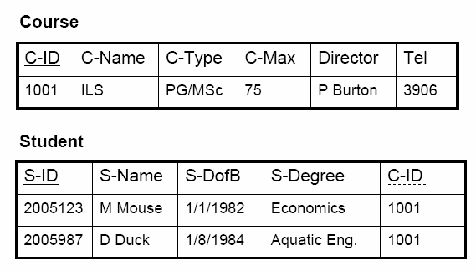
Mapping :1:N Conversion
1:N relationships, post the identifier (Primary Key) from the ‘one’ side as an attribute into the ‘many’ side
C-TYPE
C-MAX
C-NAME
Course
C-ID
TEL
DIRECTOR
Is registered
FK
N
S-DEGREE
Student
S-DOB
S-ID
S-NAME

Slide 37
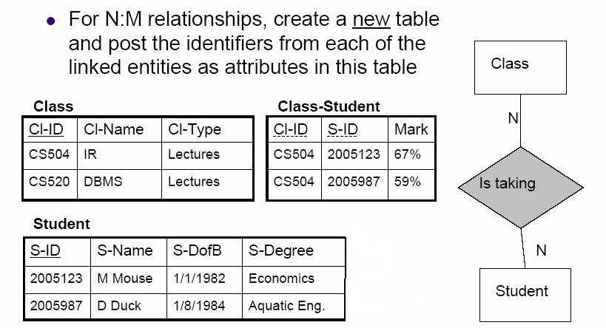
Mapping : M:N Conversion
FK
FK

Slide 38
Mapping ..N-array Relationships
ER Model Relational Model
N-ary relationship “Relationship” relation and n foreign keys
A
B
pk_{B}
pk_{A}
A
B
R
pk_{A}
pk_{B}
pk_{C}
pk_{D}
r
C
D
C
D
pk_{C}
pk_{D}

Slide 39
Mapping Weak Entities … (contd.)
ER Model Relational Model
Weak Entity Relations and combination of partial and primary keys
1
Employee
EMPLOYEE
Policy
id
id
N
Dependents
DEPENDENTS
id
name
age
name
age

Slide 40
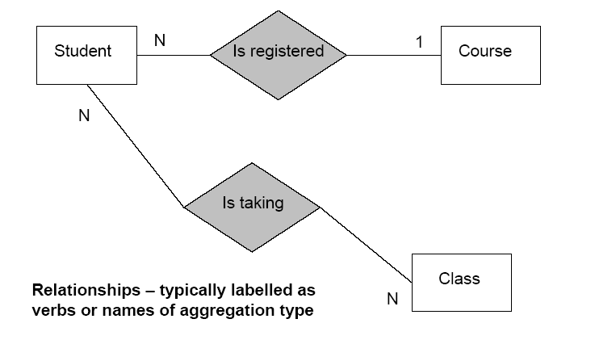
Your Turn – Map to a Relational Schema

Slide 41
Lecture Outline
ER-to-Relational Mapping Algorithm
Step 1: Mapping of Regular Entity Types
Multivalued attributes.
Composite attributes
Step 2: Mapping of Weak Entity Types
Step 3: Mapping of Binary 1:1 Relation Types
Step 4: Mapping of Binary 1:N Relationship Types.
Step 5: Mapping of Binary M:N Relationship Types.
Step 6: Mapping of N-ary Relationship Types.

Slide 42
Summary of Mapping constructs and constraints
Table 7.1 Correspondence between ER and Relational Models
ER Model Relational Model
Entity type “Entity” relation
1:1 or 1:N relationship type Foreign key (or “relationship” relation)
M:N relationship type “Relationship” relation and two foreign keys
n-ary relationship type “Relationship” relation and n foreign keys
Simple attribute Attribute
Composite attribute Set of simple component attributes
Multivalued attribute Relation and foreign key
Value set Domain
Key attribute Primary (or secondary) key

Slide 43
End of Lecture 06
Questions ?

